Slide 1

Maximum & Minimum Applied Example 2
RCET 0264 Introductory Calculus
Tim Leishman

Slide 2
Maximum & Minimum
A man wishes to fence in a rectangular plot lying next to a river. No fence is required along the river bank. If he has 800m of fence and he wishes the maximum area to be fenced, find the dimensions of the desired enclosed plot.

Slide 3
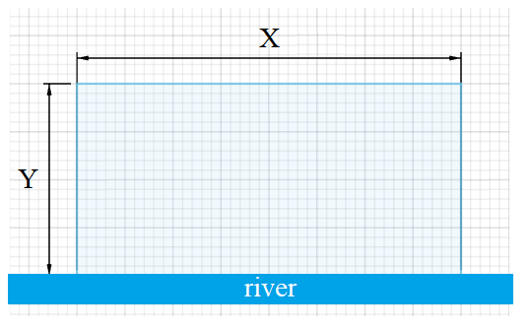
Maximum & Minimum
A man wishes to fence in a rectangular plot lying next to a river. No fence is required along the river bank. If he has 800m of fence and he wishes the maximum area to be fenced, find the dimensions of the desired enclosed plot.

Slide 4

Maximum & Minimum
A man wishes to fence in a rectangular plot lying next to a river. No fence is required along the river bank. If he has 800m of fence and he wishes the maximum area to be fenced, find the dimensions of the desired enclosed plot.
$Perimeter = 800m$
$Perimeter=Y+X+Y$
$Perimeter=2Y+X$
$800m=2Y+X$
$Area = X×Y$
$800m=2Y+X$
$X=800m−2Y$
$Area = X×Y$
$Area =\left(800m−2Y\right)×Y$
$Area =800Y −2Y^{2}$
$\frac{da}{dy}=800 −4Y$
$0=800 −4Y$
$4Y=800$
$Y=200m$

Slide 5

Maximum & Minimum
A man wishes to fence in a rectangular plot lying next to a river. No fence is required along the river bank. If he has 800m of fence and he wishes the maximum area to be fenced, find the dimensions of the desired enclosed plot.
$Perimeter = 800m$
$Perimeter=Y+X+Y$
$Perimeter=2Y+X$
$800m=2Y+X$
$Area = X×Y$
$800m=2Y+X$
$2Y=800m−X$
$Y=400m−\frac{X}{2}$
$Area =X×Y$
$Area = X×(400m−\frac{X}{2})$
$Area =400X−\frac{X^{2}}{2}$
$\frac{da}{dx}=400 −X$
$0=400 −X$
$X=400$

Slide 6

Maximum & Minimum
A man wishes to fence in a rectangular plot lying next to a river. No fence is required along the river bank. If he has 800m of fence and he wishes the maximum area to be fenced, find the dimensions of the desired enclosed plot.
$$X = 400m$$
$$Y = 200m$$
$Perimeter = 800m$
$Perimeter=200m+400m+200m$
$800m=200m+400m+200m$
$Area = X×Y$
$Area =400m×200m$
$Area =80Km^{2}$

Slide 7

Maximum & Minimum
A man wishes to fence in a rectangular plot lying next to a river. No fence is required along the river bank. If he has 800m of fence and he wishes the maximum area to be fenced, find the dimensions of the desired enclosed plot.
$$X = 400m$$
$$Y = 200m$$
$${Area}_{Max}=80Km^{2}$$
Is this in fact the Max Area?
Y = 205?
$Perimeter = 800m$
$Perimeter=Y+X+Y$
$800m=205m+X+205m$
$X=800 −205 −205$
$X=390m$
$Area = X×Y$
$Area =390m×205m$
${Area}_{not Max}=79.95Km^{2}$

Slide 8

Maximum & Minimum
A man wishes to fence in a rectangular plot lying next to a river. No fence is required along the river bank. If he has 800m of fence and he wishes the maximum area to be fenced, find the dimensions of the desired enclosed plot.
$$X = 400m$$
$$Y = 200m$$
$${Area}_{Max}=80Km^{2}$$
Is this in fact the Max Area?
Y = 195?
$Perimeter = 800m$
$Perimeter=Y+X+Y$
$800m=195m+X+195m$
$X=800 −195 −195$
$X=410m$
$Area = X×Y$
$Area =410m×195m$
${Area}_{not Max}=79.95Km^{2}$

Slide 9
Maximum & Minimum
References:
Ewen, D., Gary, J. S., & Trefzger, J. E. (2005). Technical calculus. Upper Saddle River, NJ: Pearson/Prentice Hall.
https://www.desmos.com
https://www.autodesk.com/products/fusion-360/overview

